Slide 1

Automated Financial Data Pipeline
Roy Padayao

Slide 2
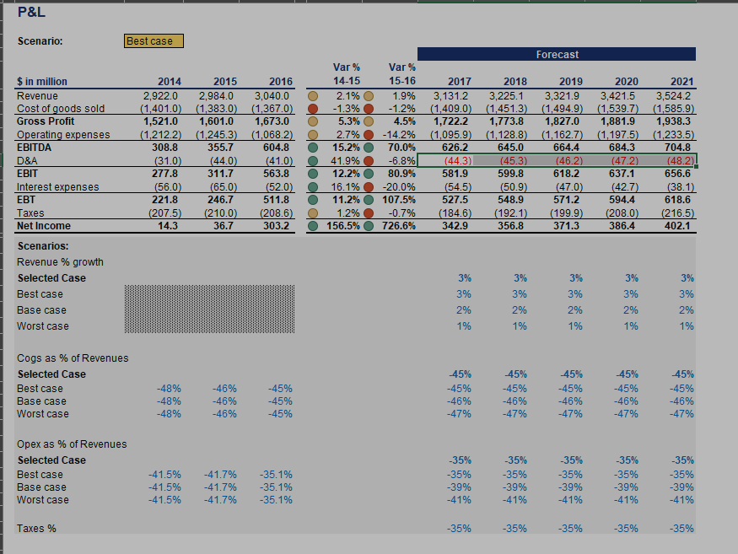
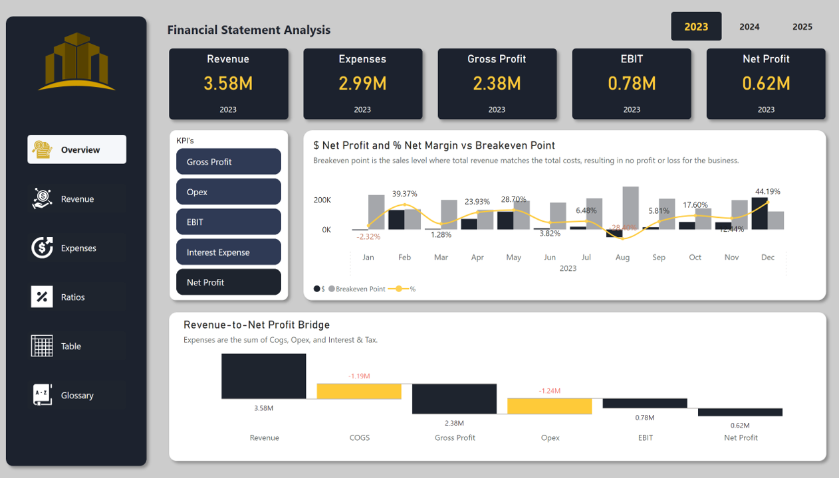
Problem: Finance teams struggle with manual reporting, reconciliation delays and are prone to errors.
Manual work
automated

Slide 3
Solution: End-to-end pipeline diagram
Data Source
ELT
Postgres
Airflow
Power BI
Automated workflows ensure clean data, reliable transformations, and real‑time dashboards

Slide 4
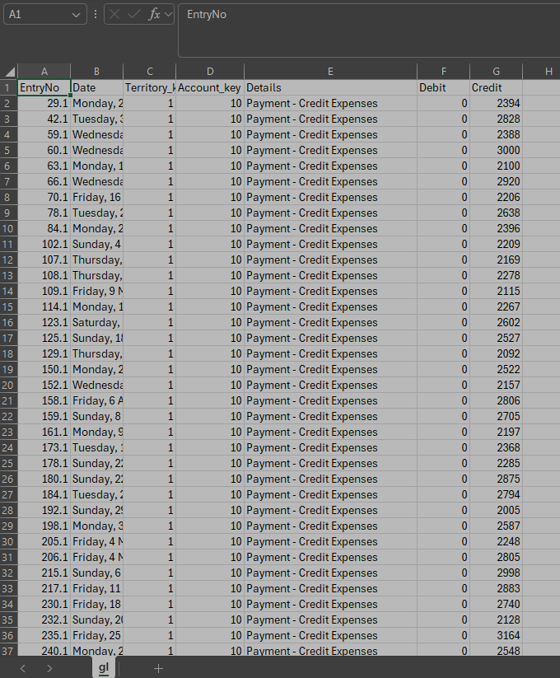
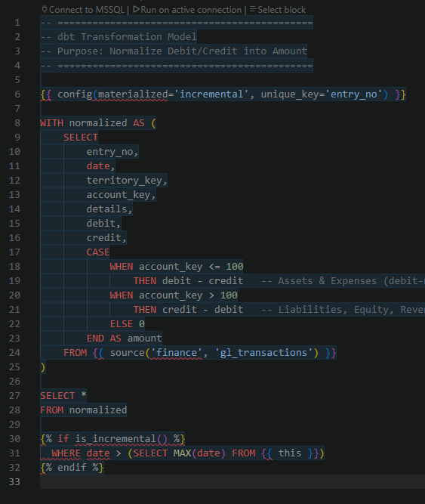
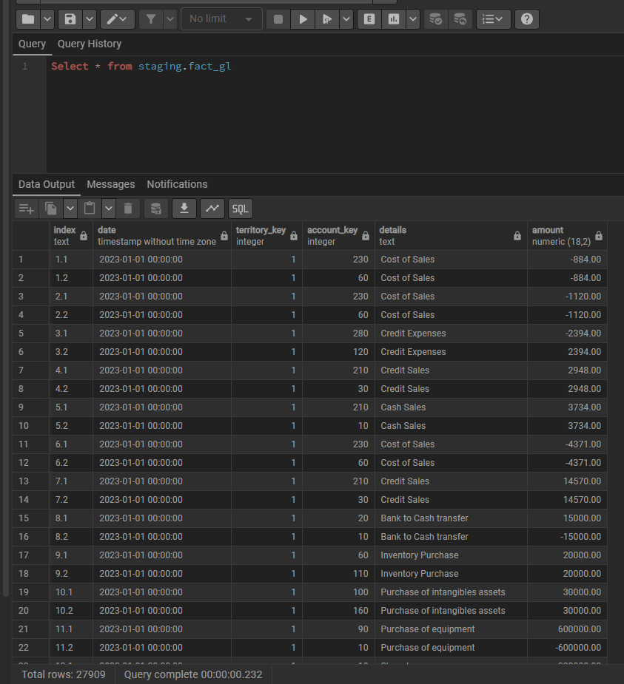
Data Ingestion: Raw general ledger data ingested into Postgres staging tables.
raw
1
transform model
2
database staging table
3

Slide 5
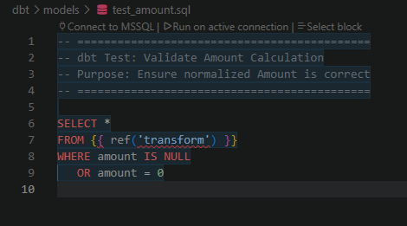
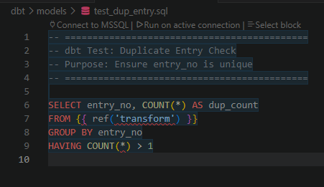
Transformation Tests (dbt) dbt models validation tests script
Data quality test
Duplicate entry test

Slide 6
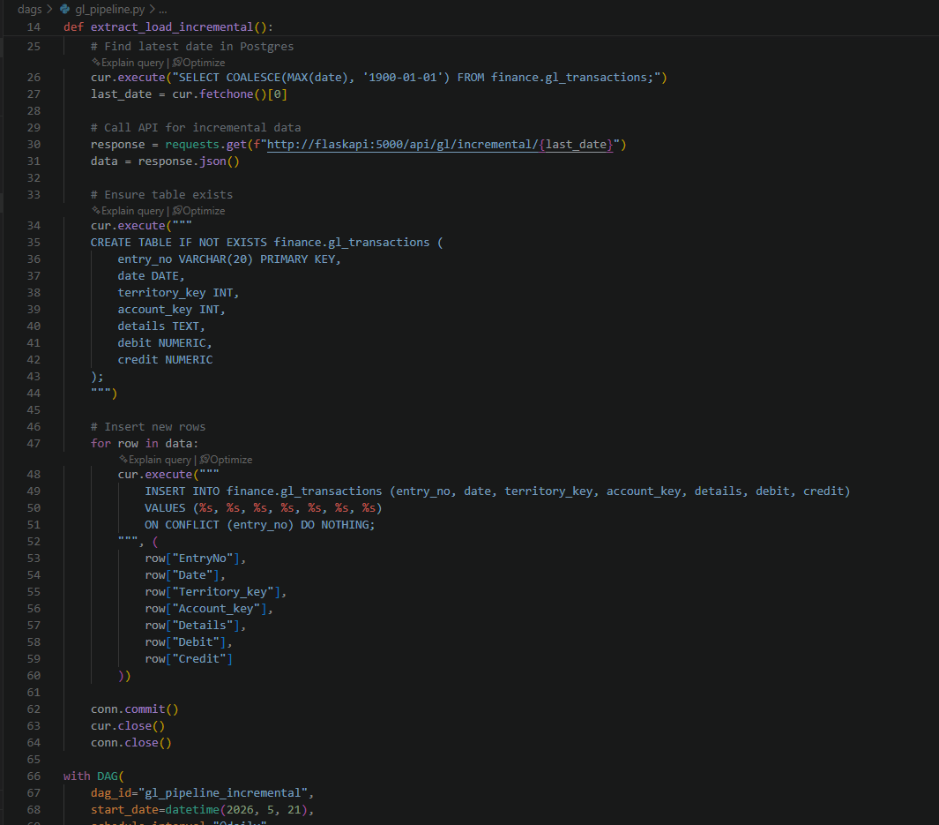
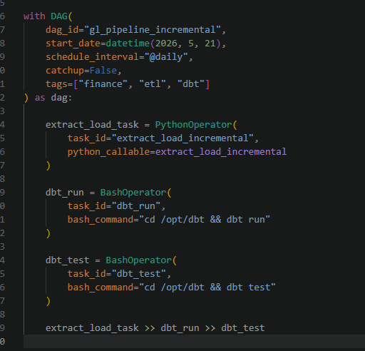
Orchestration (Airflow) Airflow DAGs orchestrate ingestion, transformation, and dashboard refresh.

Slide 7
Visualization (Power BI) An interactive Power BI dashboard delivers actionable insights for stakeholders.

Slide 8
Business Value: Automated refresh reduced manual effort by 80%. Improved accuracy and transparency in financial reporting.
Speed
Accuracy
Automation

